Slide 1


DESIGN 1
Lesson 2: Guided Practice: The Famous Grand Prix Table
Ms. Abboud • Grade 9 - Design 1 • Term 1, Week 8

Slide 2
Learning Objectives
WALT - We Are Learning To
WILF - What I'm Looking For
Build a correctly structured multi-column table, with support.
Every row has the same number of cells.
The table displays cleanly with no missing or misaligned data.

Slide 3
Frayer Model: Table Row (Review)
DEFINITION
CHARACTERISTICS
The <tr> tag: one horizontal row of a table.
The <tr> tag; one horizontal line of a table; holds cells.
TABLE ROW
EXAMPLES
NON-EXAMPLES
A row for one race: Abu Dhabi | UAE | Yas Marina Circuit.
<table> itself; a single <td>.

Slide 4
National Identity Integration
UAE Statistical Information: the UAE publishes official data in clear tables so people can compare facts quickly. This week your F1 website presents real data, including facts about the Abu Dhabi Grand Prix.

Slide 5
STARTER
Fix It: Spot the Error
A table is missing a closing </tr>. Can you find where?
What happens to the table if we leave it?
Hook • Engage & Ask
5 - 10 minutes

Slide 6
LESSON CORE
I Do: Plan Before You Code
3 columns: Grand Prix, Country, Circuit.
Every row needs exactly 3 cells: count them!
Gradual Release of Responsibility
30 - 40 minutes
Example: header row and the Abu Dhabi row
<tr>
<th>Grand Prix</th>
<th>Country</th>
<th>Circuit</th>
</tr>
<tr>
<td>Abu Dhabi</td>
<td>UAE</td>
<td>Yas Marina Circuit</td>
</tr>
1 / 3

Slide 7
LESSON CORE
We Do: Checkpoint by Checkpoint
Checkpoint 1: header row with 3 <th> cells.
Checkpoint 2: all 5 data rows, 3 <td> cells in each.
Cell in the wrong column? Count the cells in each row.
Gradual Release of Responsibility
30 - 40 minutes
2 / 3

Slide 8
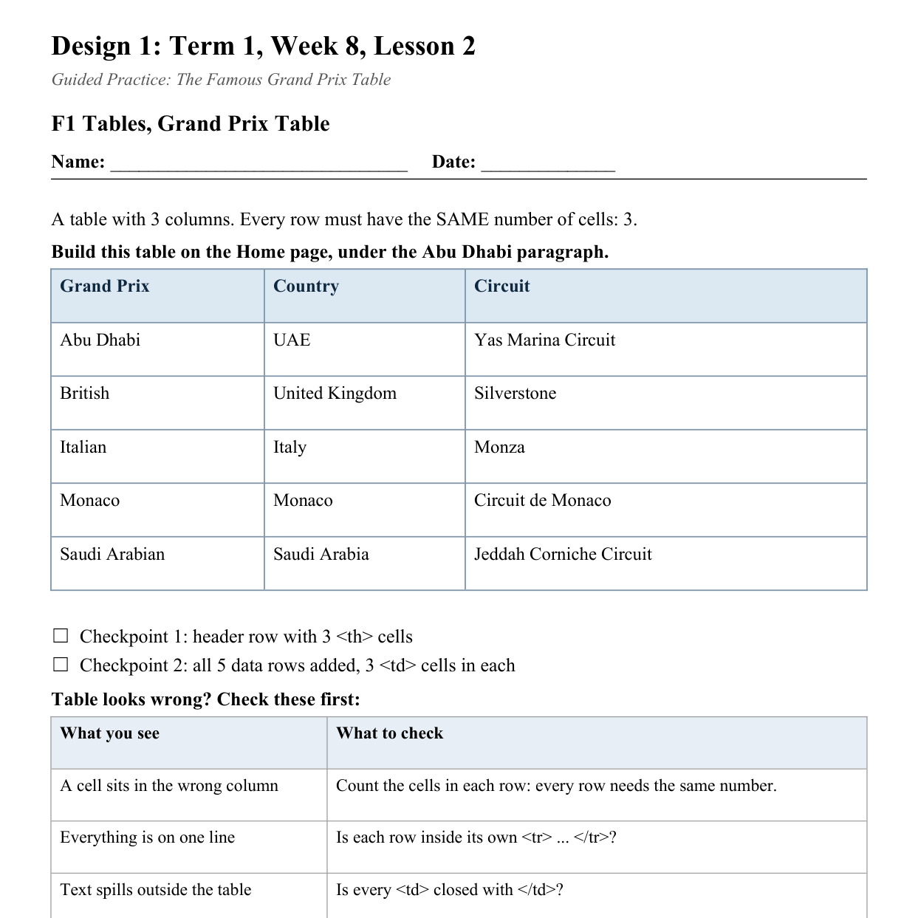
LESSON CORE
You Do: Famous Grand Prix
Finish the table on your Home page, under the Abu Dhabi paragraph.
Then do the partner check.
Activity: F1 Tables, Grand Prix Table
Gradual Release of Responsibility
30 - 40 minutes
3 / 3

Slide 9
CLOSURE
Quick Check
Submit a screenshot of your Home page table for a quick teacher check.
Transition & Extend
5 - 10 minutes

